Slide 1
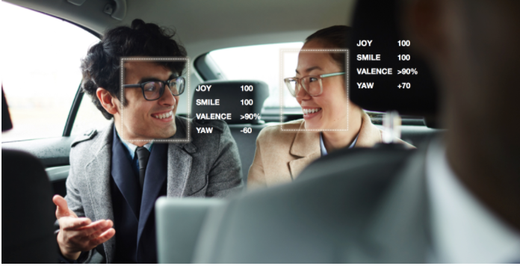
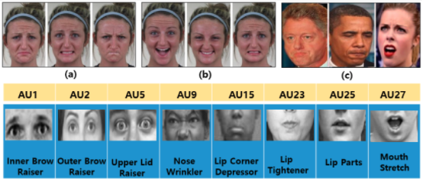
Review on Facial Emotion Recognition
https://www.affectiva.com/product/affectiva-automotive-ai-for-occupant-monitoring/
Facial emotion recognition is the process of detecting human emotions from facial expressions. Real time facial emotion recognition systems are nowadays used in a variety of ways, from automatically monitoring driver and occupant state in the car to interview purposes in companies. However, recent researches in the affective computing show that facial expressions do not reliably correspond to emotions and there is no clear mapping between them. In this project we would like to use AI solutions to reconstruct the existing technology and then have a discussion on how to improve this task.
https://www.mdpi.com/1424-8220/18/2/401/htm

